Slide 1
DEMO I
ZOLTÁN NÉMETH

Slide 2
ZOLTÁN NÉMETH
Chemistry, economics
Rap music
Play drums
Quattrocento paintings

Slide 3
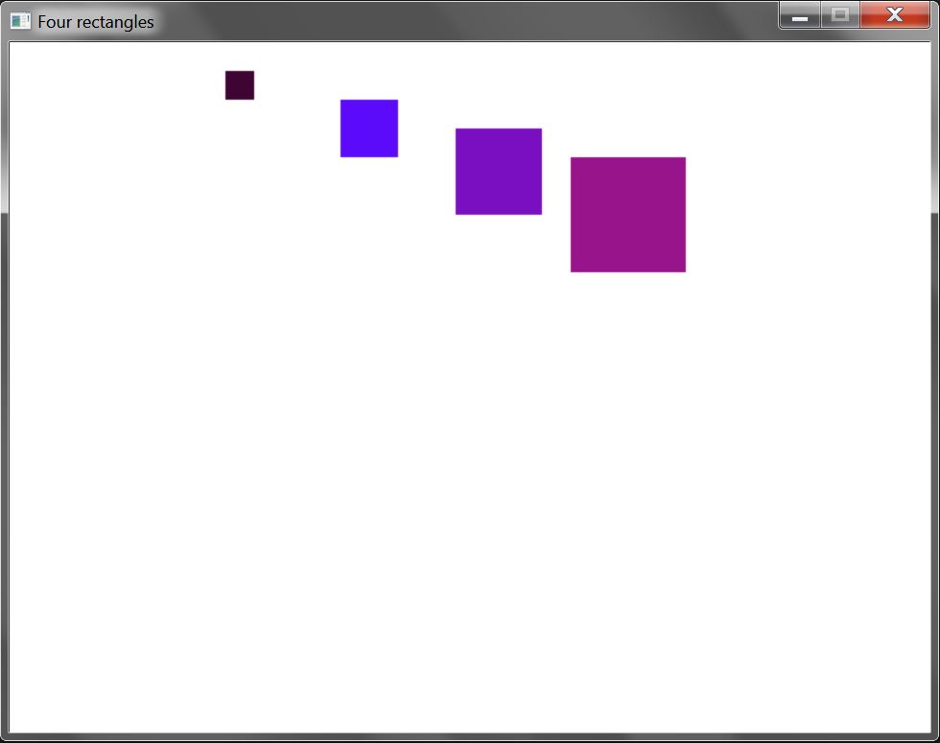
EXERCISE: FOUR RECTANGLES

Slide 4
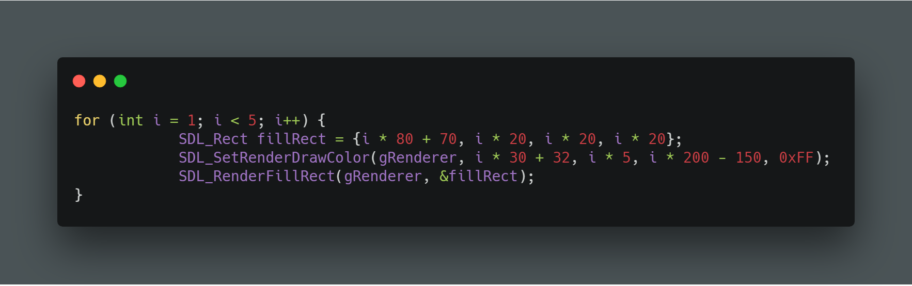
EXERCISE: FOUR RECTANGLES
Code should be written in int(main)

